Slide 1
PERFORMANCE AND RELIABILITY EVALUATION OF PV MODULES
Dr. RAJESH KUMAR
DIRECTOR
SOLAR ENERGY CENTRE
MINISTRY OF NEW & RENEWABLE ENERGY

Slide 2
Introduction
MNRE launched the JNNSM with a target of deployment of 20,000 MW grid interactive PV Power plant from June, 2010 till 2020
1. Under the programme India had 2180 MW of installed grid connected solar capacity as of December 2013
2. The installed off grid PV capacity has reached 150 MW
3. Deployment of 20 million square meters of collectors.
4. Under the second phase of JNNSM which runs from 2013-1017 India aims to support the deployment of 3GW of solar power projects. Several states have their own programme as well

Slide 3
The solar photovoltaic power projects mainly comprises of the PV modules of following technologies
Crystalline Si
Thin film Si double or triple tandem
CuInSe2
The PV modules are required to withstand all sort of whether
conditioning throught a period of 20 years without a degradation of
less than 10 %

Slide 4
In order to access the reliable operation of the PV modules in the field the comprehensive test faclities have been upgraded at SEC for crystalline as well as thin film modules. The upgraded facility at SEC is capable of conducting the full range of qualification testing as per the International standards for PV modules of size upto 200cm x 200cm.

Slide 5
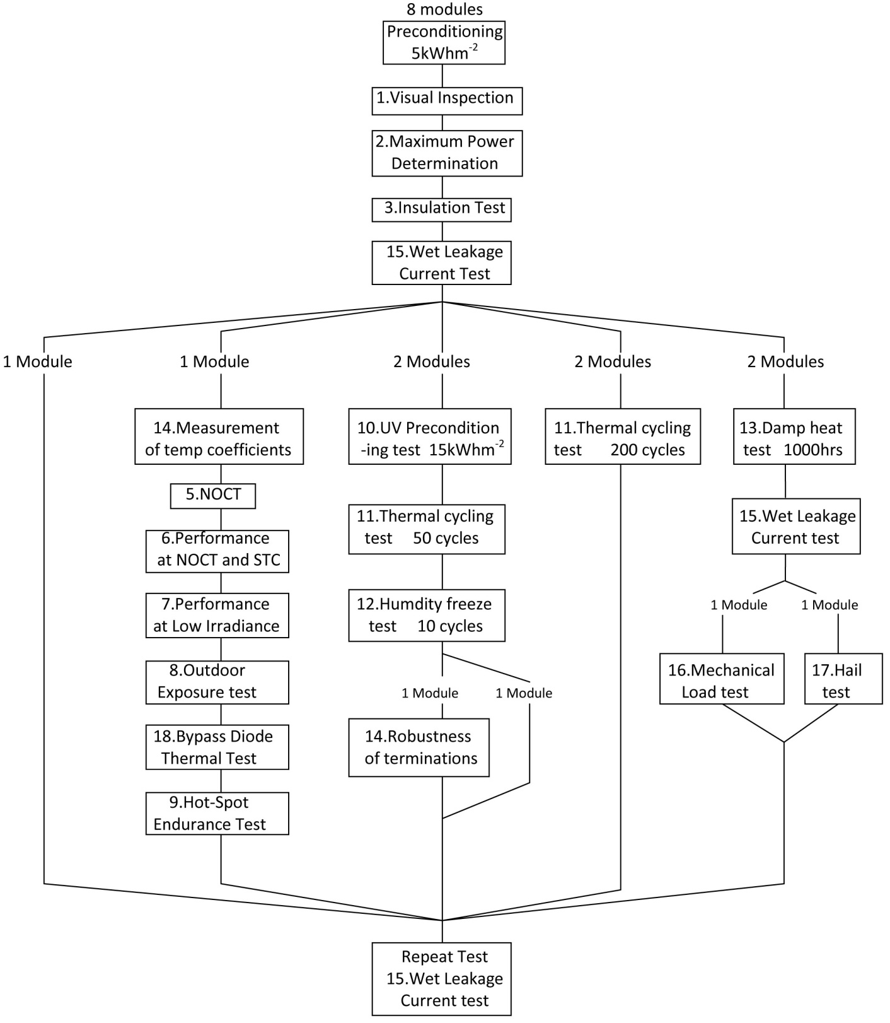
TEST SEQUENCE
FOR
QUALIFICATION
TESTING

Slide 6
SAMPLING
The manufacturer has to submit eight identical modules taken at random from a production batch . The modules shall have been manufactured from specified materials and components in accordance with the relevent drawings and process sheets and have been subjected to the manufcature’s normal inspection, quality control and production acceptence procedure.
The modules shall be complete in every detail and shall be accompnied by the manufcature’s handling, mounting and connection instructions, including the maximum permissible system voltage
Each module shall carry the following clear and indelible marking
- Name monogram or symbol of manufacturer
- type or model No.
- serial No. & maximum system voltage for which the module is
suitable

Slide 7
Testing
Before starting the testing all modules including the control module shall be exposed to sun light to an irradiance level of 5.5 kWh per square meter.
The modules shall be divided into groups and subjected to the qualification test sequence

Slide 8
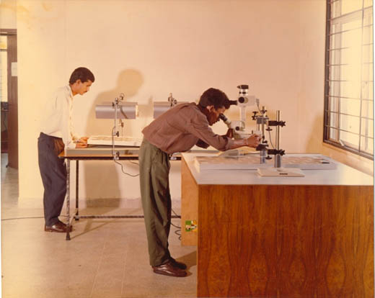
1. Visual Inspection
Objective: To detect any visual defects in the module.
The visual inspection test facility comprises of the following:
a) Arrangement to inspect the module under an illumination of 1000 lux.
b) A microscope to carefully inspect and record the cracked/broken cells, faulty interconnections or joints, tacky surfaces of plastic materials, cells touching one another or the frame and any other conditions which may affect the performance.

Slide 9
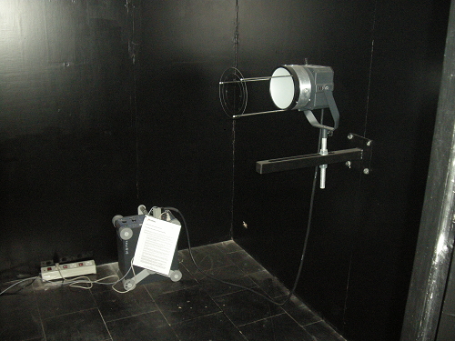
2. STC Performance Measurement
Objective: To determine how the performance of the module varies with load at Standard Test Conditions(1000 Wm⁻², 25⁰C cell temperature, with the IEC 60904-3 reference solar spectral irradiance distribution).
Flash lamp of the Endeas Quick sun solar simulator

Slide 10
The Equipment:
The Quick Sun 700A Sun Simulator
This is a class A, simulator being used for performance evaluation of PV modules conforms to class A sun simulator specifications as per IEC 60904-9 and can measure the STC performance of PV modules of size up to 200 cm x 200 cm . For making the performance measurements a flash pulse is triggered and the irradiance is measured with monitor cell. When the target irradiance level is reached the I-V measurement is initiated. The module is swept from short circuit to open circuit condition and during the 2 ms period of the pulse the voltage, current and the irradiance signals are recorded simultaneously. The measured data is corrected for irradiance and temperature to defined conditions. The system measures 4096 raw data points for each signal and the data is averaged in group of eight to obtain 512, I-V data points.
LARGE AREA SUN SIMULATOR QUICKSUN 700A

Slide 11
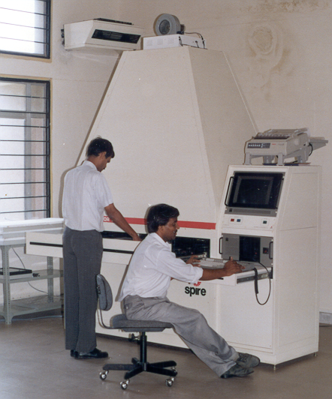
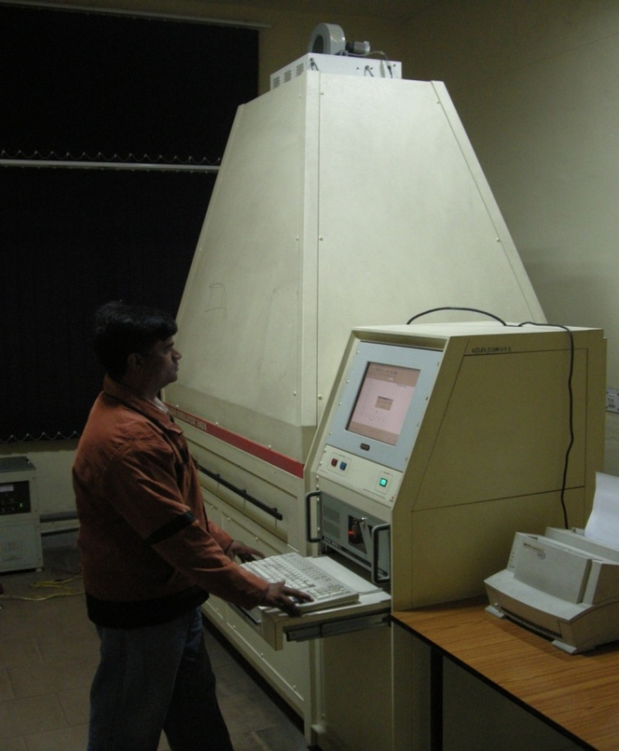
Spire 240A
This is another class A sun simulator available in the facility that can be used to test modules with maximum dimensions 120 cm x 80 cm. It is currently being used for Temperature coefficient measurement, Low Irradiance and STC performance measurement.
SPIRE 240A Sun Simulator

Slide 12
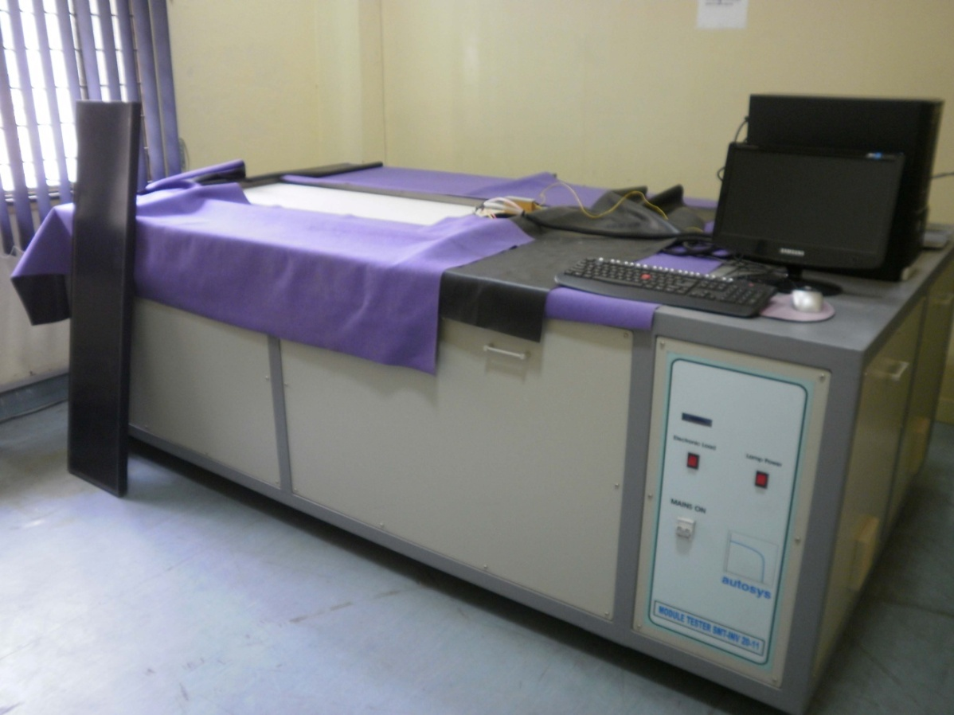
Autosys InvaSun: This is a class B sun simulator that can test modules up to 200 cm x 110 cm area. It is currently being used for routine module testing and training. It is not being used for certification purpose.
Autosys InvSun Sun Simulator

Slide 13
3. Insulation Test
Objective: To determine whether the module is sufficiently well insulated between current-carrying parts and the frame or the outside world.
The Equipment:
High Voltage Insulation Tester (Fluke )
Model: 2956 AA
Input: 230 VAC 50/60 Hz , 5 A
Output: 0-5000 VDC
Meg. Ohms: 2-10000 at 500 VDC to 2-100000 at 5000 VDC

Slide 14
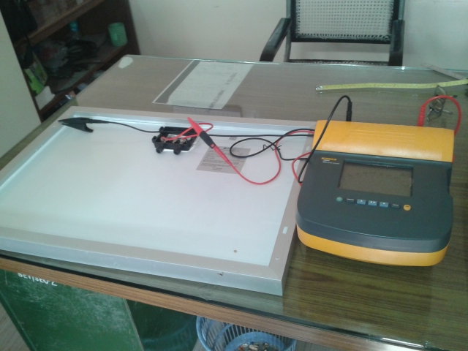

Slide 15
4. Measurement of Temperature Coefficients
Objective: The purpose is to determine the temperature coefficients of current (α), voltage(β), and peak power (δ) from module measurements.
Equipment:
The Temperature coefficients can be measured by using the environmental chamber and sun simulator .

Slide 16
5. NOCT Measurement
Objective: NOCT is defined as the equilibrium mean solar cell junction temperature within an open-rack mounted module in the following standard reference environment (SRE):
Tilt angle: 45⁰ from the horizontal
Total irradiance: 800 Wm⁻²
Ambient temperature: 20⁰C
Wind speed: 1 ms⁻¹
Electrical load: nil(open circuit)
The Equipment:
Out door test bed for mounting the module , pyranometer, ambient temperature sensor, cell temperature sensor, data acquisition system and wind speed sensor.

Slide 17
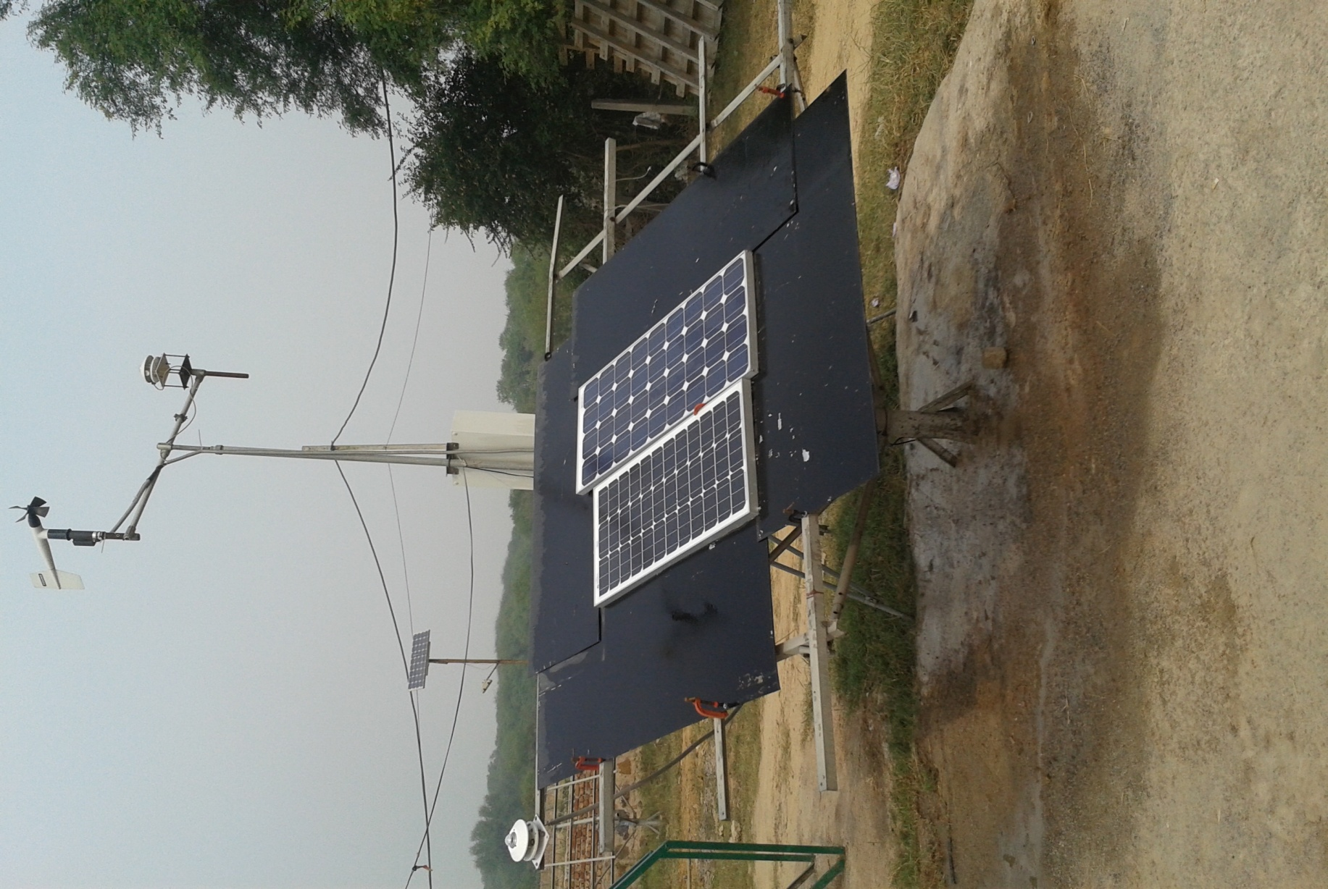

Slide 18
6. Performance at NOCT
Objective: To determine how the performance of the module varies with load at NOCT (800 Wm⁻², 25⁰C cell temperature, with the IEC 60904-3 reference solar spectral irradiance distribution).
The Equipment:
Performance at NOCT is evaluated by using the environmental chamber and sun simulators.

Slide 19
7. Performance at Low Irradiance
Objective: To determine how the electrical performance of the module varies with load at 25⁰C and an irradiance of 200 Wm⁻² in accordance with IEC 60904-1.
The Equipment:
The Performance at low irradiance is evaluated by using the available sun simulator by setting the intensity at 200Wm⁻².

Slide 20
8. Out Door Exposure Test
Objective: To make preliminary assessment of the ability of the module to withstand exposure to outdoor conditions and to reveal any synergistic degradation effects which may not be detected by laboratory tests.
The Equipment:
Out door test bed, for mounting of the module , pyranometer, Temperature sensor, data acquisition system and arrangement to operate the module near the maximum power point.

Slide 21
9. Bypass Diode Thermal Test
Objective: To assess the adequacy of the thermal design and relative long –term reliability of the by-pass diodes used to limit the detrimental effects of module hot-spot susceptibility.
Equipment:
Environmental chamber for heating the module to a temperature of 75⁰C ± 5⁰C.
Temperature probe for measuring and recording the temperature of the module to an accuracy of ±1⁰C.
Power supply for applying a current equal to 1.25 times the STC short-circuit current of the module under test and means for monitoring the flow of current through the module, throughout the test.

Slide 22
10. Hot-Spot Endurance Test
Objective: To determine the ability of the module to withstand hot-spot heating effects, for example solder melting or deterioration of the encapsulation. This defect could be provoked by cracked or mismatched cells, interconnect failures, partial shadowing or soiling.
Equipment:
Set of opaque covers for test cell shadowing in 5% increments and sun simulator

Slide 23
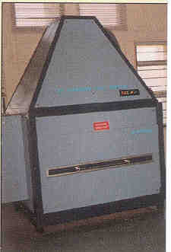
11. UV Preconditioning Test
Objective: To precondition the module with ultra-violet (UV) radiation before the thermal cycle/humidity freeze tests to identify those materials and adhesive bonds that are susceptible to UV degradation.
Equipment:
UV exposure system to control the temperature of the module while it is irradiated by UV light (280-385 nm , at 60 ⁰C ± 5 ⁰C).
Temperature probes for measuring and recording the temperature of the module .
UV radiometer for measuring the irradiation of the UV light produced by the UV light source at the test plane of the module.

Slide 24
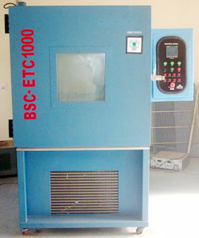
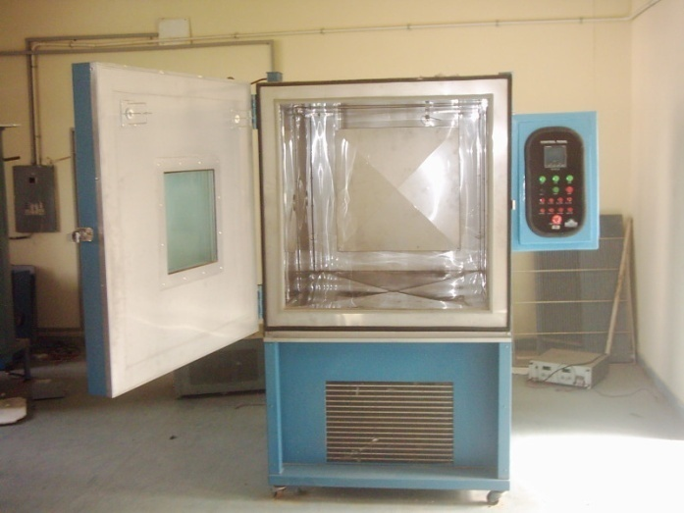
12. Thermal Cycling Test
Objective: To determine the ability of the module to withstand thermal mismatch, fatigue and other stresses caused by repeated changes of temperature.
Equipment:
Environmental chambers with automatic temperature control .
Power supply for applying a current equal to the STC peak power current of the module(s) under test and monitoring the flow of current through each module during the test.

Slide 25
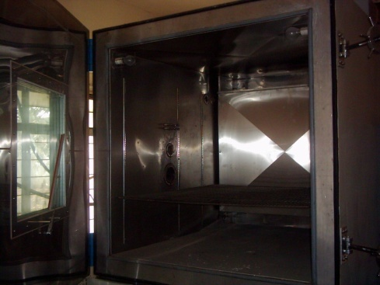
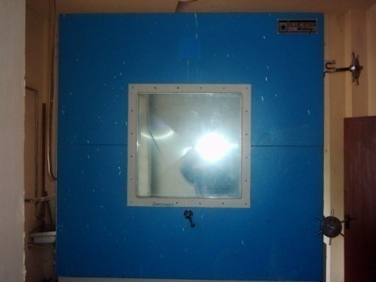
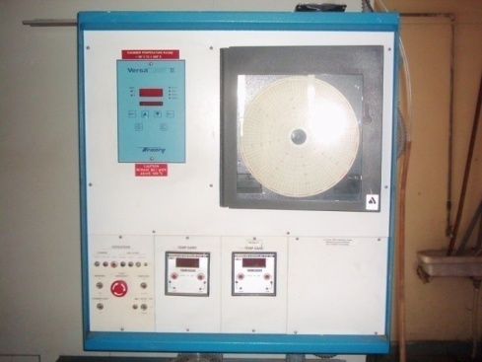
13. Humidity Freeze Test
Objective: To determine the ability of the module to withstand the effects of high temperature and humidity followed by sub-zero temperatures.
Equipment:
Environmental chambers with automatic temperature control and humidity .
Multimeter to monitor the continuity of the internal circuit of each module during test.

Slide 26
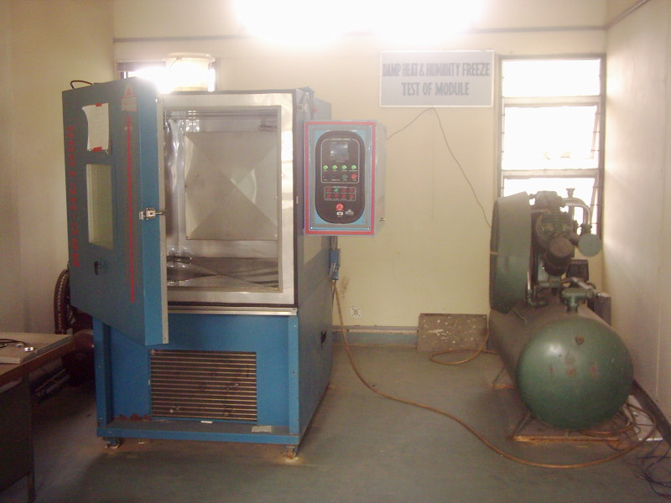
14. Damp Heat Test
Objective: To determine the ability of the module to withstand the effects of long term penetration of humidity.
Equipment:
Environmental chamber with humidity and temperature control.

Slide 27
LARGE SIZE ENVIRONMENTAL CHAMBERS

Slide 28
15. Wet Leakage Current Test
Objective: To evaluate the insulation of the module under wet operating conditions and verify that moisture from rain, fog, dew, or melted snow does not enter the active parts of the module circuitry, where it might cause corrosion, a ground fault or a safety hazard.
Equipment:
A water container for wetting the module
Spray equipment for keeping the module wet during test
Insulation tester to measure the insulation resistance.

Slide 29
16. Robustness of Terminations Test
Objective: To determine that the terminations and attachment of the terminations to the body of the module will withstand such stresses as are likely to be applied during normal assembly or handling operations.
Equipment: A set of weights along with hanging arrangement .

Slide 30
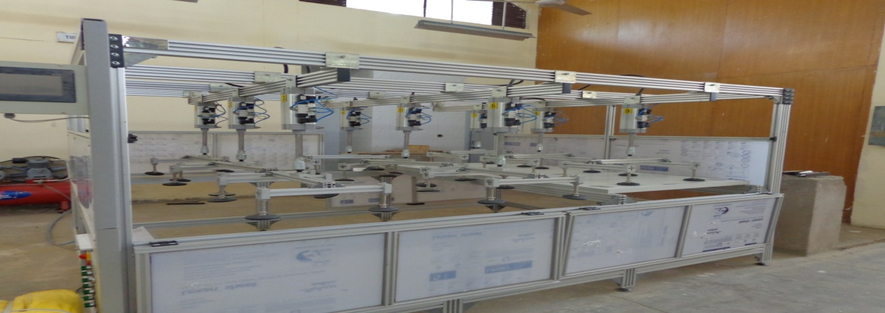
17) Mechanical Load Test
Objective: The purpose of this test is to determine the ability of the module to withstand wind, snow, static or ice loads.
Equipment:
Mechanical load tester which enables the modules to be mounted front-side up or front-side down. The test base shall enable the module to deflect freely during the load application.
Instrumentation to monitor the electrical continuity of the module during the test.

Slide 31
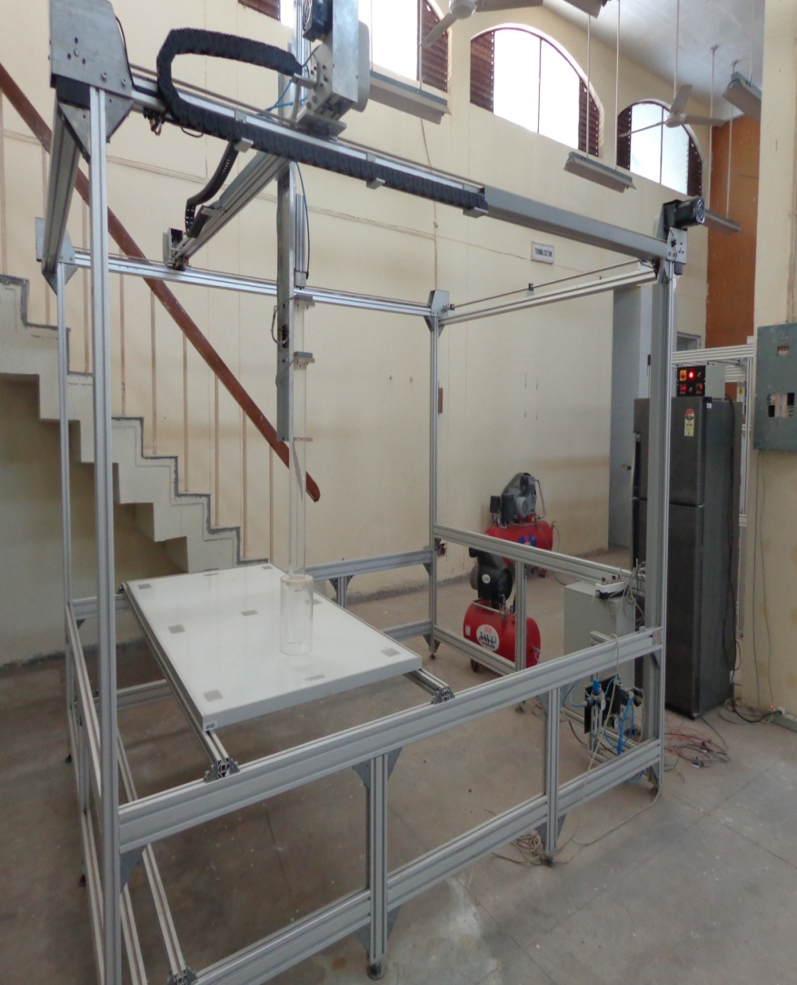
18. Hail Impact test
The objective of this test is to ascertain the mechanical integrity of the PV module during hail impact.
Test conditions:
Circular Ice balls of 25mm dia are bombarded with a velocity of 17 m/sec.

Slide 32
LIGHT SOAKING STATION

Slide 33
ISSUES
The modules conforming to IEC 61215 /IEC 61646 are having performance degradation in the power plants.
More cases on low output of PV plants are due to PID (potential Induced degradation ) reported in recent years

Slide 34
PID DEGRADATION
In HV PV array the module at the terminal end furthest from the grounded terminal aquires HV throughut the normal operation and incur leakage current (LC) from cell to frame leakage paths and down to their mechanical support and earth ground.
The HV leakage current that occur continuosly during operation can degrade electrical contacts or PV absorber materialand/or lead to delamination of layers, Typically leading to high series resistance lower performance and even failure

Slide 35
PATHWAYS FOR LC
Conductance through the top glass to frame
Through interfaces or EVA
Through the back sheet or glass

Slide 36
FACTORS INFLUENCING PID
1. Harsh environment
( hot humid and salty)
2. System in Floating mode

Slide 37
LOSS IN POWER WITH MODULE POSITION
S.N. | Voc | Isc | Vmp | Imp | PMax | Rated Pmax | LOSS
1. | 61.9 | 2.989 | 48.8 | 2.496 | 121.8 | 125 | 2.56 %
2. | 62.1 | 2.944 | 49.5 | 2.444 | 120.9 | 125 | 3.28 %
3. | 63.2 | 2.908 | 49.1 | 2.439 | 119.7 | 125 | 4.24 %
4. | 62.3 | 3.004 | 49.2 | 2.513 | 123.6 | 130 | 4.92%
5. | 61.9 | 3.054 | 48.0 | 2.559 | 122.9 | 130 | 5.46 %
6. | 62.2 | 3.019 | 49.0 | 2.481 | 121.5 | 130 | 6.53%
7. | 62.0 | 3.064 | 48.2 | 2.514 | 121.2 | 130 | 6.77 %

Slide 40
On going projects
Stability and Performance of Photovoltaics (STAPP) project: It is the Indo-UK project for Understanding the stability and long-term performance of PV module and systems
Project for Solar Energy Research Institute for India and the United States (SERIIUSS): It is the Indo-US project for the development of solar electric technologies by lowering the cost per watt of photovoltaics (PV) and concentrated solar power (CSP).
Quality infrastructure of Solar photovoltaic in India, a joint project with PTB, Germany
Module reliability and performance evaluation, a joint project with NREL

Slide 41
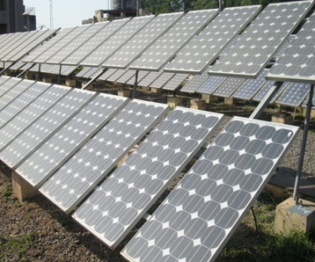
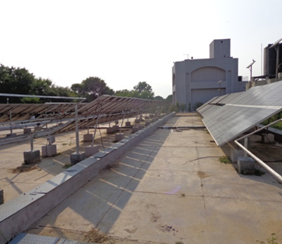
Mono Crystalline Technology PV Module test bed
Size of the test bed 15 kWp
Test bed installed in 1999
11 different manufactures modules are installed (REIL, ARM, XL, BP Solar, CEL, SIMENS, TITAN, P.SOLAR, BEL, BHEL and Webel-SL)
Fixed tilt at latitude (28⁰)

Slide 42
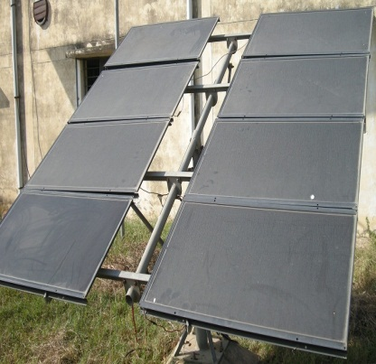
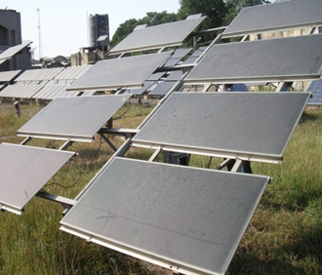
Thin Film technology test bed
Installed at 2002 under SEC-NREL project
Initial capacity around 21 kWp
Present capacity around 6 kWp
CIGS (2.1 kWp), BP-Solarex (Double tandem) (1.08 kWp), Unisolar (triple tandem) (1.5 kWp) CdTe (1.2 kWp)

Slide 43
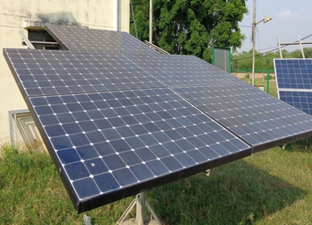
Sun power module test bed
Installed on January 2013
Sun power latest ‘Maxeon Gen 3’ solar cell technology
Capacity 1.635 kWp
Module wattage are 327 Wp

Slide 44
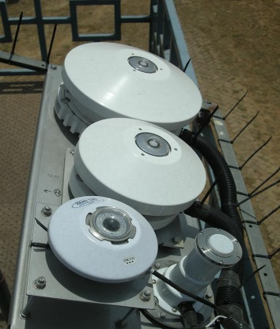
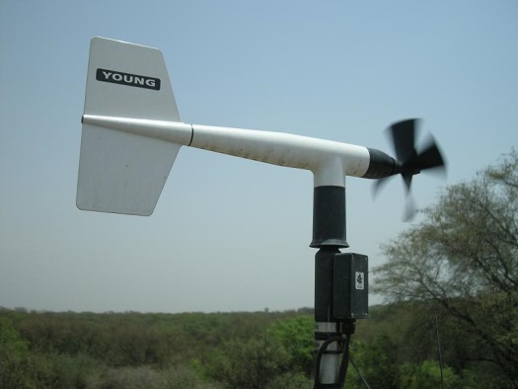
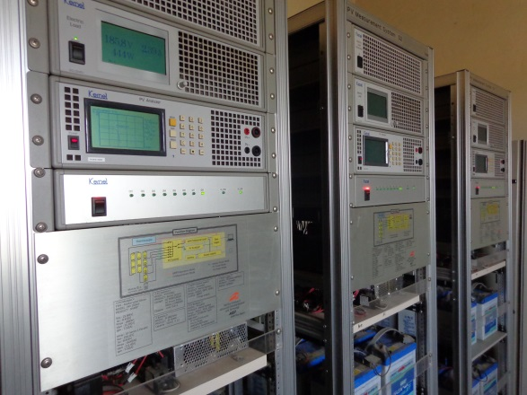
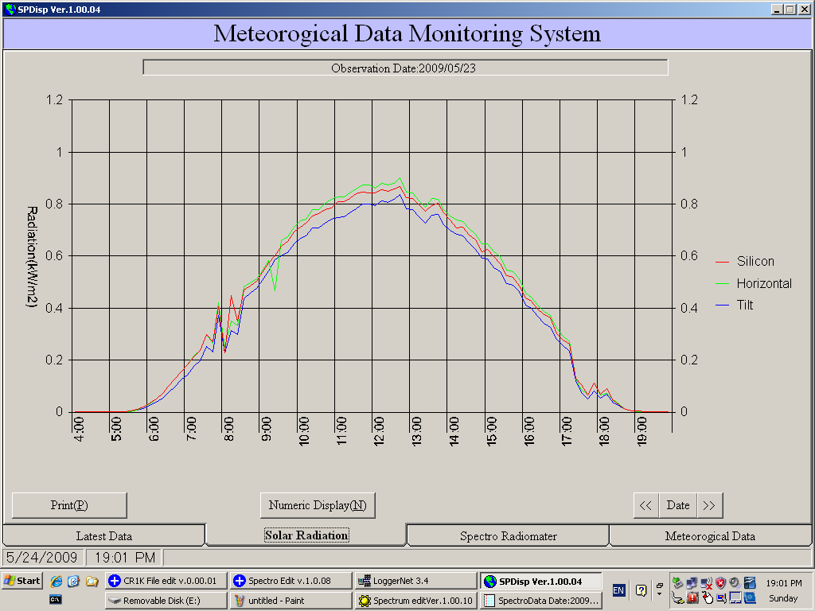

Slide 45
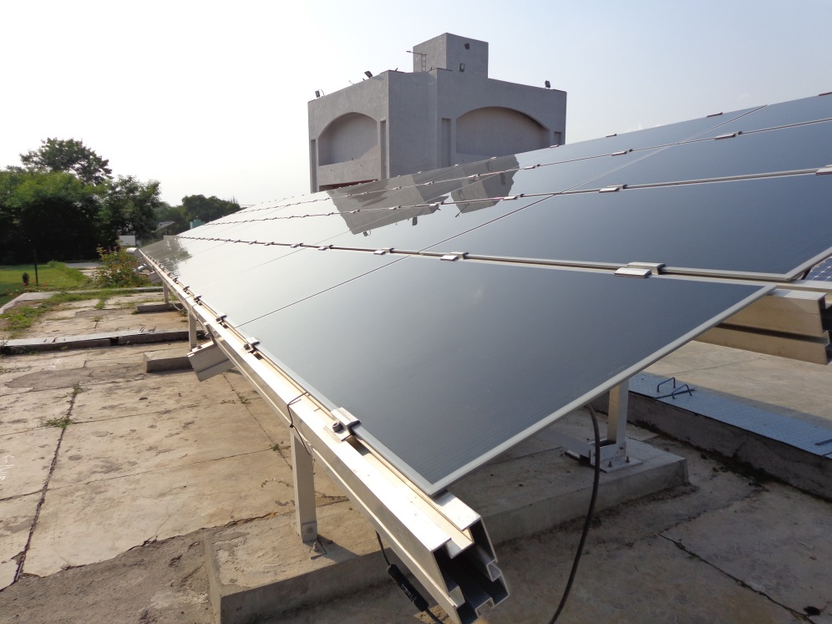
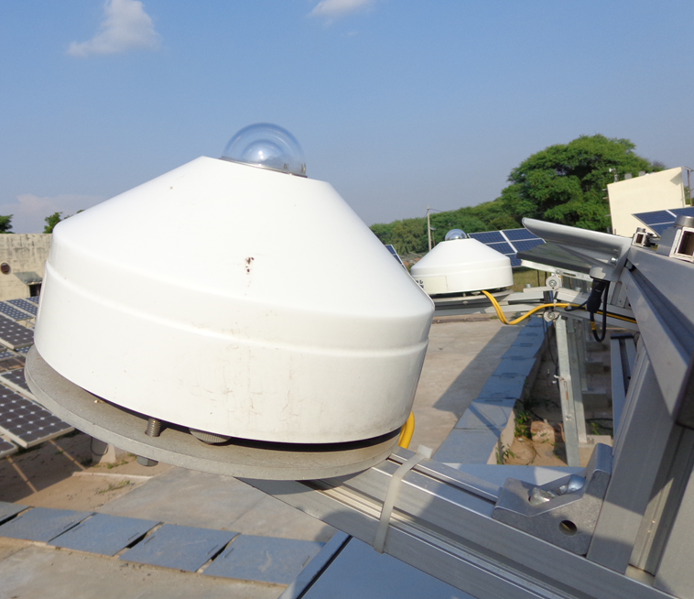
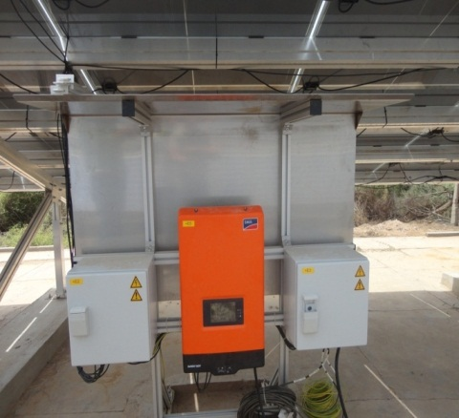
Dust effect analysis set up
CdTe test bed

Slide 46
THANK YOU

